Slide 1
22
Cost-Volume-Profit
Learning Objectives
1
Explain variable, fixed, and mixed costs and the relevant range.
2
Apply the high-low method to determine the components of mixed costs.
3
Prepare a CVP income statement to determine contribution margin.
4
Compute the break-even point using three approaches.
5
Determine the sales required to earn target net income and determine margin of safety.
6
Use CVP analysis to respond to changes in the business environment.

Slide 2
LEARNING
OBJECTIVE
Explain variable, fixed, and mixed costs and the relevant range.
1
Cost Behavior Analysis is the study of how specific costs respond to changes in the level of business activity.
Some costs change; others remain the same.
Helps management plan operations and decide between alternative courses of action.
Applies to all types of businesses and entities.
Starting point is measuring key business activities.
LO 1

Slide 3
Variable Costs
Costs that vary in total directly and proportionately with changes in the activity level.
Example: If the activity level increases 10 percent, total variable costs increase 10 percent.
Example: If the activity level decreases by 25 percent, total variable costs decrease by 25 percent.
Variable costs remain the same per unit at every level of activity.
LO 1

Slide 4
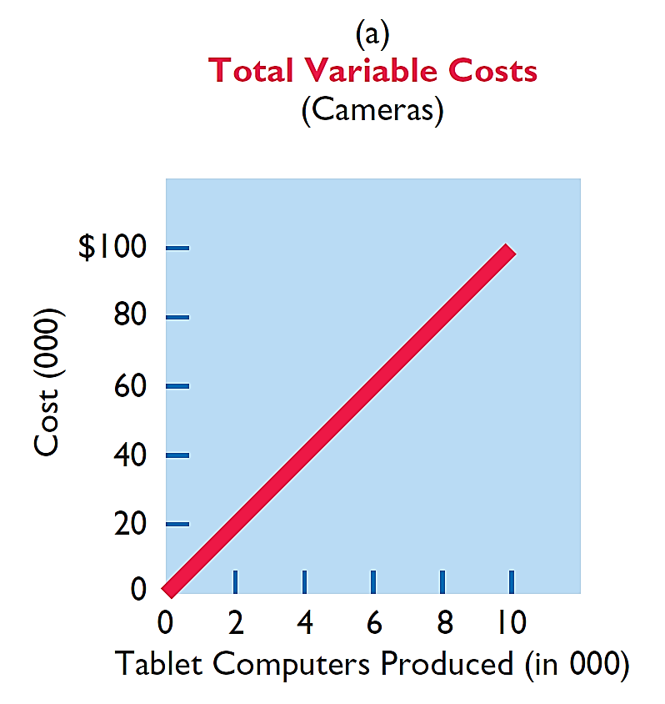
Variable Costs
Illustration: Damon Company manufactures tablet computers that contain a $10 camera. The activity index is the number of tablets
produced. As Damon manufactures each tablet, the total cost of the cameras used increases by $10. As part (a) of Illustration 22-1 shows, total cost of the cameras will be $20,000 if Damon produces 2,000 tablets, and $100,000 when it produces 10,000 tablets. We also can see that a variable cost remains the same per unit as the level of activity changes.
Illustration 22-1
LO 1

Slide 5
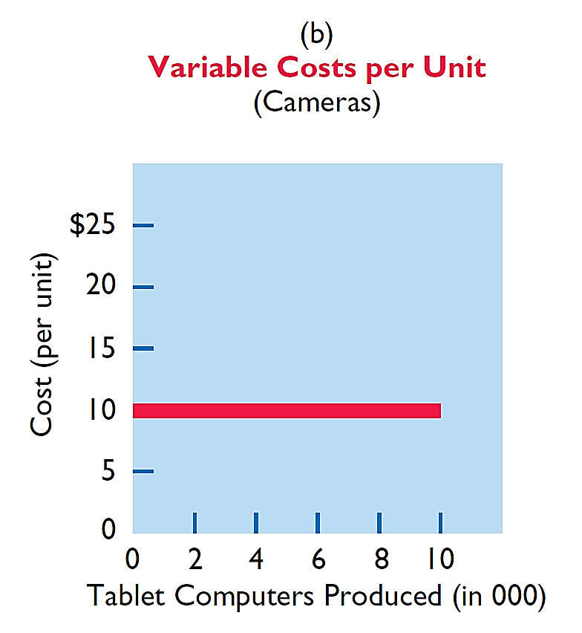
Variable Costs
Illustration: Damon Company manufactures tablet computers that contain a $10 camera. The activity index is the number of tablets
produced. As Damon manufactures each tablet, the total cost of the cameras used increases by $10. As part (b) of Illustration 22-1 shows, the unit cost of $10 for the camera is the same whether Damon produces 2,000 or 10,000 tablets.
Illustration 22-1
LO 1

Slide 6
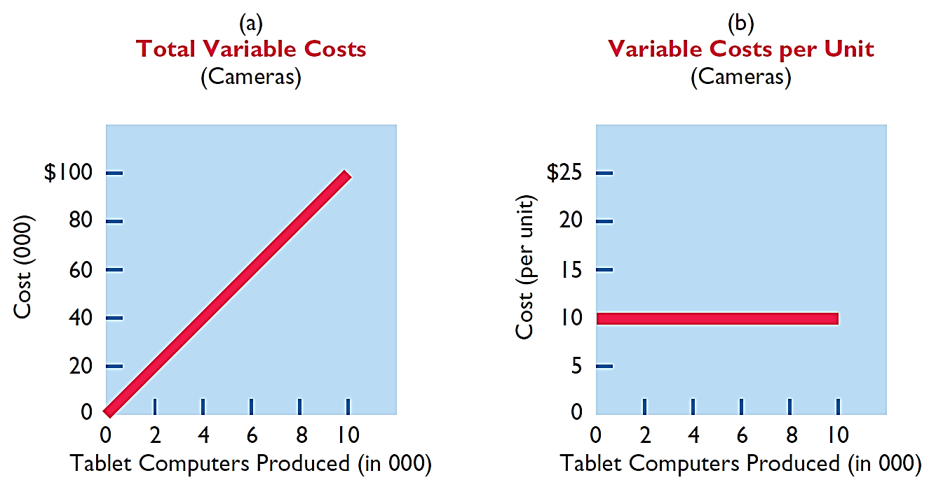
Variable Costs
Illustration 22-1
Behavior of total and unit variable costs
LO 1

Slide 7
Variable Costs
Question
Variable costs are costs that:
a. Vary in total directly and proportionately with changes in the activity level.
b. Remain the same per unit at every activity level.
c. Neither of the above.
d. Both (a) and (b) above.
LO 1

Slide 8
Fixed Costs
Costs that remain the same in total regardless of changes in the activity level within a relevant range.
Fixed cost per unit cost varies inversely with activity: As volume increases, unit cost declines, and vice versa
Examples:
Property taxes
Insurance
Rent
Depreciation on buildings and equipment
LO 1

Slide 9
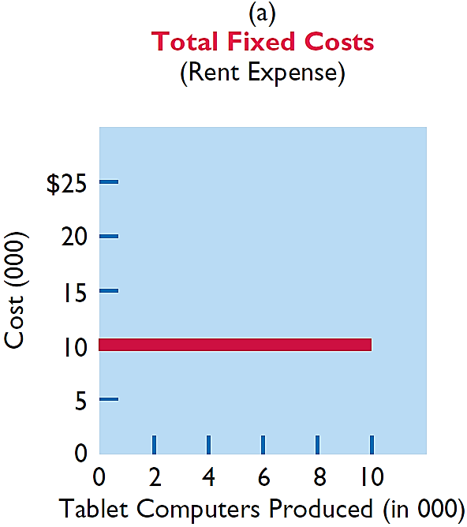
Fixed Costs
Illustration: Damon Company leases its productive facilities at a cost of $10,000 per month. Total fixed costs of the facilities will remain
constant at every level of activity, as part (a) of Illustration 22-2 shows.
Illustration 22-2
LO 1

Slide 10
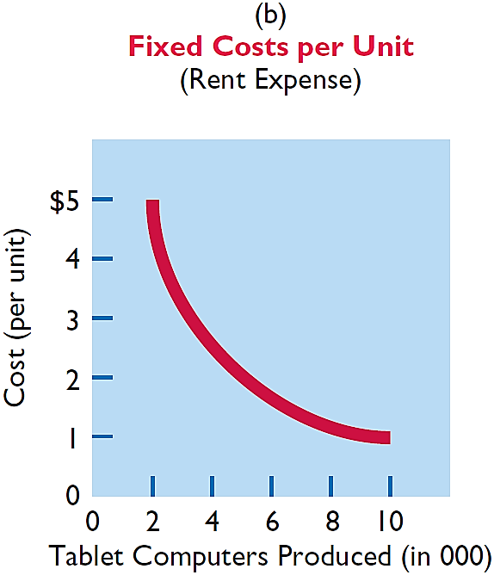
Fixed Costs
Illustration: Damon Company leases its productive facilities at a cost of $10,000 per month. Total fixed costs of the facilities will remain
constant at every level of activity. But, on a per unit basis, the cost of rent will decline as activity increases, as part (b) of Illustration 22-2 shows. At 2,000 units, the unit cost per tablet computer is $5 ($10,000 ÷ 2,000). When Damon produces 10,000 tablets, the unit cost of the rent is only $1 per tablet ($10,000 ÷ 10,000).
Illustration 22-2
LO 1

Slide 11
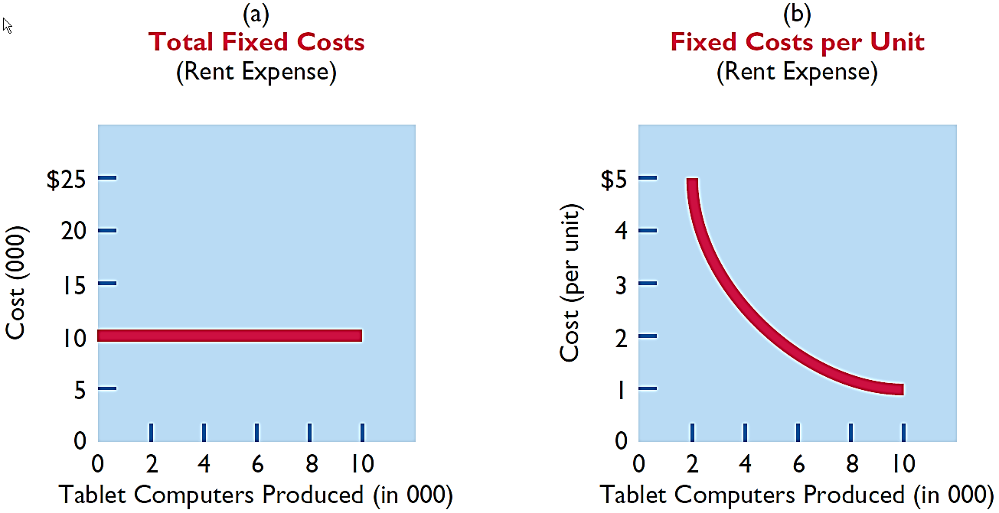
Fixed Costs
Illustration 22-2
Behavior of total and unit fixed costs
LO 1

Slide 12
LEARNING
OBJECTIVE
Prepare a CVP income statement to determine contribution margin.
3
Cost-volume-profit (CVP) analysis is the study of the effects of changes in costs and volume on a company’s profits.
Important in profit planning.
Critical factor in management decisions as
Setting selling prices,
Determining product mix, and
Maximizing use of production facilities.
LO 3

Slide 13
Basic Components
Question
Which of the following is not involved in CVP analysis?
Sales mix.
Unit selling prices.
Fixed costs per unit.
Volume or level of activity.
LO 3

Slide 14
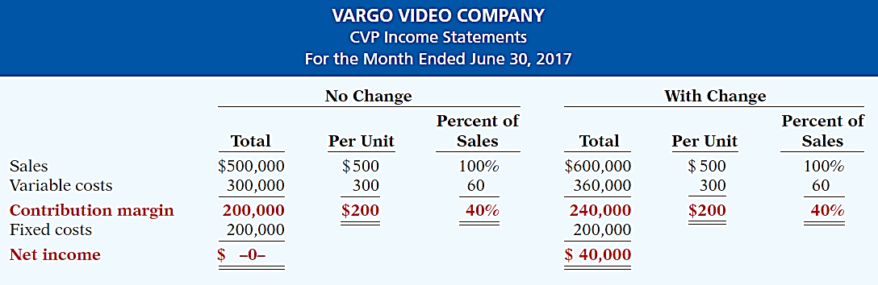
CVP Income Statement
CONTRIBUTION MARGIN RATIO
Assume Vargo Video’s current sales are $500,000 and it wants to know the effect of a $100,000 (200-unit) increase in sales.
Illustration 22-18
LO 3

Slide 15
CVP Income Statement
Question
Contribution margin:
a. Is revenue remaining after deducting variable costs.
b. May be expressed as contribution margin per unit.
c. Is selling price less cost of goods sold.
d. Both (a) and (b) above.
LO 3

Slide 16
DO IT!
3
CVP Income Statement
Ampco Industries produces and sells a cell phone-operated thermostat. Information regarding the costs and sales of thermostats during September 2017 are provided below.
Unit selling price of thermostat $85
Unit variable costs $32
Total monthly fixed costs $190,000
Units sold 4,000
Prepare a CVP income statement for Ampco Industries for the month of September. Provide per unit values and total values.
LO 3

Slide 17
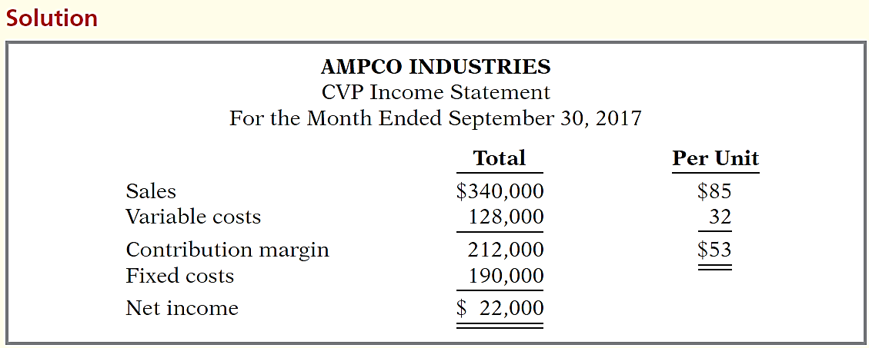
DO IT!
3
CVP Income Statement
Prepare a CVP income statement for Ampco Industries for the month of September. Provide per unit values and total values.
LO 3

Slide 18
LEARNING
OBJECTIVE
Compute the break-even point using three approaches.
4
Break-Even Analysis
Process of finding the break-even point level of activity at which total revenues equal total costs (both fixed and variable).
Can be computed or derived
from a mathematical equation,
by using contribution margin, or
from a cost-volume profit (CVP) graph.
Expressed either in sales units or in sales dollars.
LO 4

Slide 19
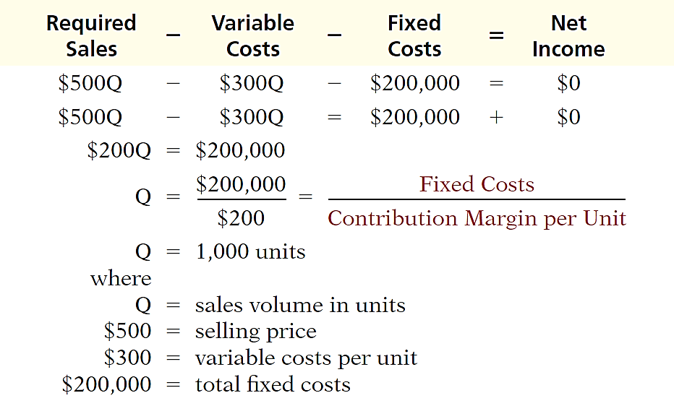
Mathematical Equation
Break-even occurs where total sales equal variable costs plus fixed costs; i.e., net income is zero
Computation of break-even point in units.
Illustration 22-20
LO 4

Slide 20
Contribution Margin Technique
At the break-even point, contribution margin must equal total fixed costs
(CM = total revenues – variable costs)
Break-even point can be computed using either contribution margin per unit or contribution margin ratio.
LO 4

Slide 21
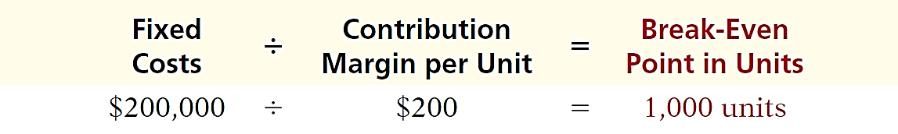
Contribution Margin Technique
CONTRIBUTION MARGIN IN UNITS
When the break-even-point in units is desired, contribution margin per unit is used in the following formula which shows the computation for Vargo Video:
Illustration 22-21
Formula for break-even point
in units using unit contribution
margin
LO 4

Slide 22

Contribution Margin Technique
CONTRIBUTION MARGIN RATIO
When the break-even-point in dollars is desired, contribution margin ratio is used in the following formula which shows the computation for Vargo Video:
Illustration 22-22
Formula for break-even point
in dollars using contribution
Margin ratio
LO 4

Slide 23
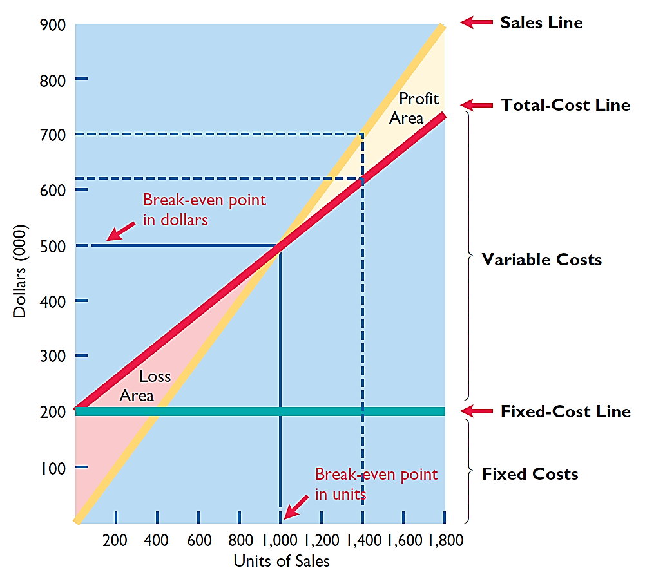
Graphic Presentation
Because this graph also shows costs, volume, and profits, it is referred to as a cost-volume-profit (CVP) graph.
Illustration 22-23
CVP graph
LO 4

Slide 24
Break-Even Analysis
Question
Gossen Company is planning to sell 200,000 pliers for $4 per unit. The contribution margin ratio is 25%. If Gossen will break even at this level of sales, what are the fixed costs?
$100,000.
$160,000.
$200,000.
$300,000.
LO 4

Slide 25
DO IT!
4
Break-Even Analysis
Lombardi Company has a unit selling price of $400, variable costs per unit of $240, and fixed costs of $180,000. Compute the break-even point in units using (a) a mathematical equation and (b) contribution margin per unit.
Variable Costs
Fixed Costs
Net Income
Sales
-
-
=
$400Q
-
$240Q
-
$180,000
=
0
$160Q
-
$180,000
Q
=
1,125 units
LO 4

Slide 26
DO IT!
4
Break-Even Analysis
Lombardi Company has a unit selling price of $400, variable costs per unit of $240, and fixed costs of $180,000. Compute the break-even point in units using (a) a mathematical equation and (b) contribution margin per unit.
Fixed Costs
Contribution Margin per Unit
Break-Even Point in Units
÷
=
$180,000
÷
$160
=
1,125 units
LO 4

Slide 27
LEARNING
OBJECTIVE
Determine the sales required to earn target net income and determine margin of safety.
5
Target Net Income
Level of sales necessary to achieve a specified income.
Can be determined from each of the approaches used to determine break-even sales/units:
from a mathematical equation,
by using contribution margin technique, or
from a cost-volume profit (CVP) graph.
Expressed either in sales units or in sales dollars.
LO 5

Slide 28

Target Net Income
MATHEMATICAL EQUATION
Formula for required sales to meet target net income.
Illustration 22-24
LO 5

Slide 29
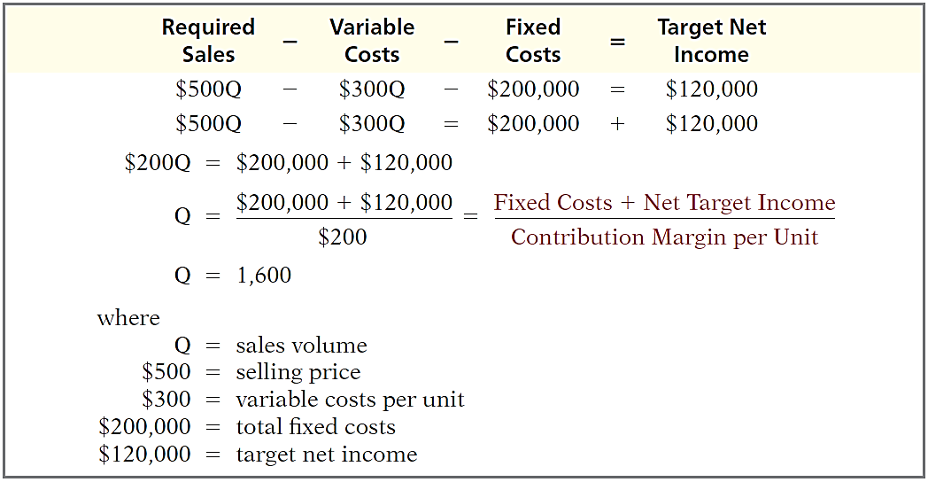
Target Net Income
MATHEMATICAL EQUATION
Using the formula for the break-even point, simply include the desired net income as a factor.
Illustration 22-25
LO 5

Slide 30
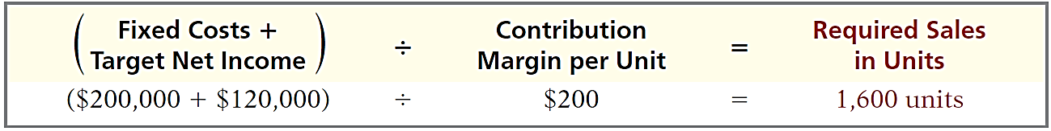
Target Net Income
CONTRIBUTION MARGIN TECHNIQUE
To determine the required sales in units for Vargo Video:
Illustration 22-26
Formula for required sales in
units using unit contribution
margin
LO 5

Slide 31
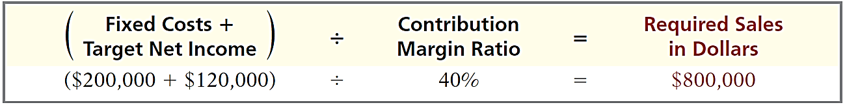
Target Net Income
CONTRIBUTION MARGIN TECHNIQUE
To determine the required sales in dollars for Vargo Video:
Illustration 22-27
Formula for required sales
in dollars using contribution
margin ratio
LO 5

Slide 32
Target Net Income
GRAPHIC PRESENTATION
Suppose Vargo Video sells 1,400 camcorders. Illustration 22-23 shows that a vertical line drawn at 1,400 units intersects the sales line at $700,000 and the total cost line at $620,000. The difference between the two amounts represents the net income (profit) of $80,000.
Illustration 22-23
LO 5

Slide 33
Target Net Income
Question
The mathematical equation for computing required sales to obtain target net income is:
Required sales =
Variable costs + Target net income.
Variable costs + Fixed costs + Target net income.
Fixed costs + Target net income.
No correct answer is given.
LO 5

Slide 34
DO IT!
Break-Even, Margin of Safety, and Target Net Income
5
Zootsuit Inc. makes travel bags that sell for $56 each. For the coming year, management expects fixed costs to total $320,000 and variable costs to be $42 per unit. Compute break-even point in dollars using the contribution margin (CM) ratio.
Contribution margin ratio = [($56 - $42) ÷ $56] = 25%
Break-even sales in dollars = $320,000 ÷ 25% = $1,280,000
LO 5

Slide 35
DO IT!
Break-Even, Margin of Safety, and Target Net Income
5
Zootsuit Inc. makes travel bags that sell for $56 each. For the coming year, management expects fixed costs to total $320,000 and variable costs to be $42 per unit. Compute the sales dollars required to earn net income of $410,000.
Required sales in dollars =
($320,000 + $410,000) ÷ 25% = $2,920,000
LO 5

